Slide 1
IBM University Engagement Project Submission
“Exploring the Power of Agentic AI with IBM Granite and LangFlow”

Slide 2

Project Tile – Power System Fault Detection using ML
Domain of Project – Energy / Electrical Engineering (Power Systems)
Student Name | Recent Passport Photo | Email ID | Mobile number [WhatsApp]
Niranjana P |  | niranjanap167@gmail.com | 9751988319

Slide 3
Problem Statement -
Problem Statement : Power System Fault Detection and Classification (No. 41)
The Challenge
Faults in power distribution systems such as line breakage, transformer failure and overheating cause outages, equipment damage and loss of grid stability. Manual inspection and fixed-threshold protection are slow and cannot learn from past data. Operators need a fast and accurate way to detect and classify faults from electrical and environmental measurements.
The Objective
Build a machine learning model and web app that detects and classifies power system faults from sensor data. The solution should:
Data Preparation – Clean the Kaggle Power System Faults dataset (506 records): duplicates, missing values, encoding, leakage check.
Model Training – Train Random Forest and XGBoost with class-balanced weights and select the best by macro F1.
Robust Evaluation – Report accuracy, precision, recall, macro F1, confusion matrix and 5-fold cross-validation.
Fault Classification – Predict Line Breakage, Transformer Failure or Overheating with a confidence score.
Web Application – Streamlit app for single prediction, batch CSV prediction and model performance view.
IBM Cloud Deployment – Use Cloud Object Storage, Watson Studio (AutoAI) and Watson Machine Learning on Lite plans.

Slide 4
Proposed Solution -
Proposed Solution: ML-Based Power System Fault Classifier
The proposed solution is a machine learning pipeline and web application that detects and classifies power system faults from electrical and environmental measurements. It is built with Python (scikit-learn, XGBoost), Streamlit and IBM Cloud Lite services, and the code was developed with the help of IBM Bob.
The dataset has 506 records with voltage, current, power load, temperature, wind speed, fault duration, down time, weather, maintenance status and component health. Data is cleaned, categorical fields are encoded, and the data is split 80/20 with stratification.
The system consists of four key stages:
Data Preprocessing removes duplicates, handles missing values, encodes labels and checks for data leakage.
Model Training & Evaluation trains Random Forest and XGBoost with class-balanced weights, selects the best model by macro F1 and checks it with 5-fold cross-validation.
IBM Cloud Training & Deployment stores the dataset in Cloud Object Storage, runs an AutoAI experiment in Watson Studio and deploys the model with Watson Machine Learning.
Streamlit Application offers single prediction, batch CSV prediction with downloadable results and a model performance tab with plots.
The app shows the predicted fault, confidence, probability chart and a plain-English explanation of each fault class to guide maintenance decisions.
Overall, this solution delivers an end-to-end fault diagnosis tool that makes power system monitoring faster, more consistent and data-driven.

Slide 5
Technology Used
Python, scikit-learn & XGBoost – For data preprocessing, Random Forest / XGBoost model training and evaluation
IBM Cloud (Lite plan) – Cloud Object Storage for the dataset, Watson Studio and AutoAI for cloud training, and Watson Machine Learning for model deployment
IBM Bob – AI coding assistant used to generate, run and troubleshoot the training pipeline and the app
Streamlit & Plotly – For the interactive web app, probability charts and batch CSV prediction
Kaggle Power System Faults dataset – 506 records of electrical and environmental measurements
Pandas, NumPy, Matplotlib, Seaborn – Data handling and plots (confusion matrix, feature importance)

Slide 6
ML pipeline component Used -
1) Data Loader – Reads the Kaggle CSV and inspects shape, columns, missing values and class distribution.
2) Preprocessing - Drops duplicates, handles missing values, encodes categorical fields and labels, checks for data leakage.
3) Model Training - Random Forest and XGBoost with class-balanced weights on a stratified 80/20 split; best model chosen by macro F1.
4) Evaluation - Accuracy, precision, recall, macro F1, confusion matrix, feature importance and 5-fold cross-validation.
5) Streamlit App - Tabs for Single Prediction, Batch Prediction and Model Performance.
6) IBM Cloud components - Cloud Object Storage, Watson Studio (AutoAI / notebook) and Watson Machine Learning (Lite plans).

Slide 7
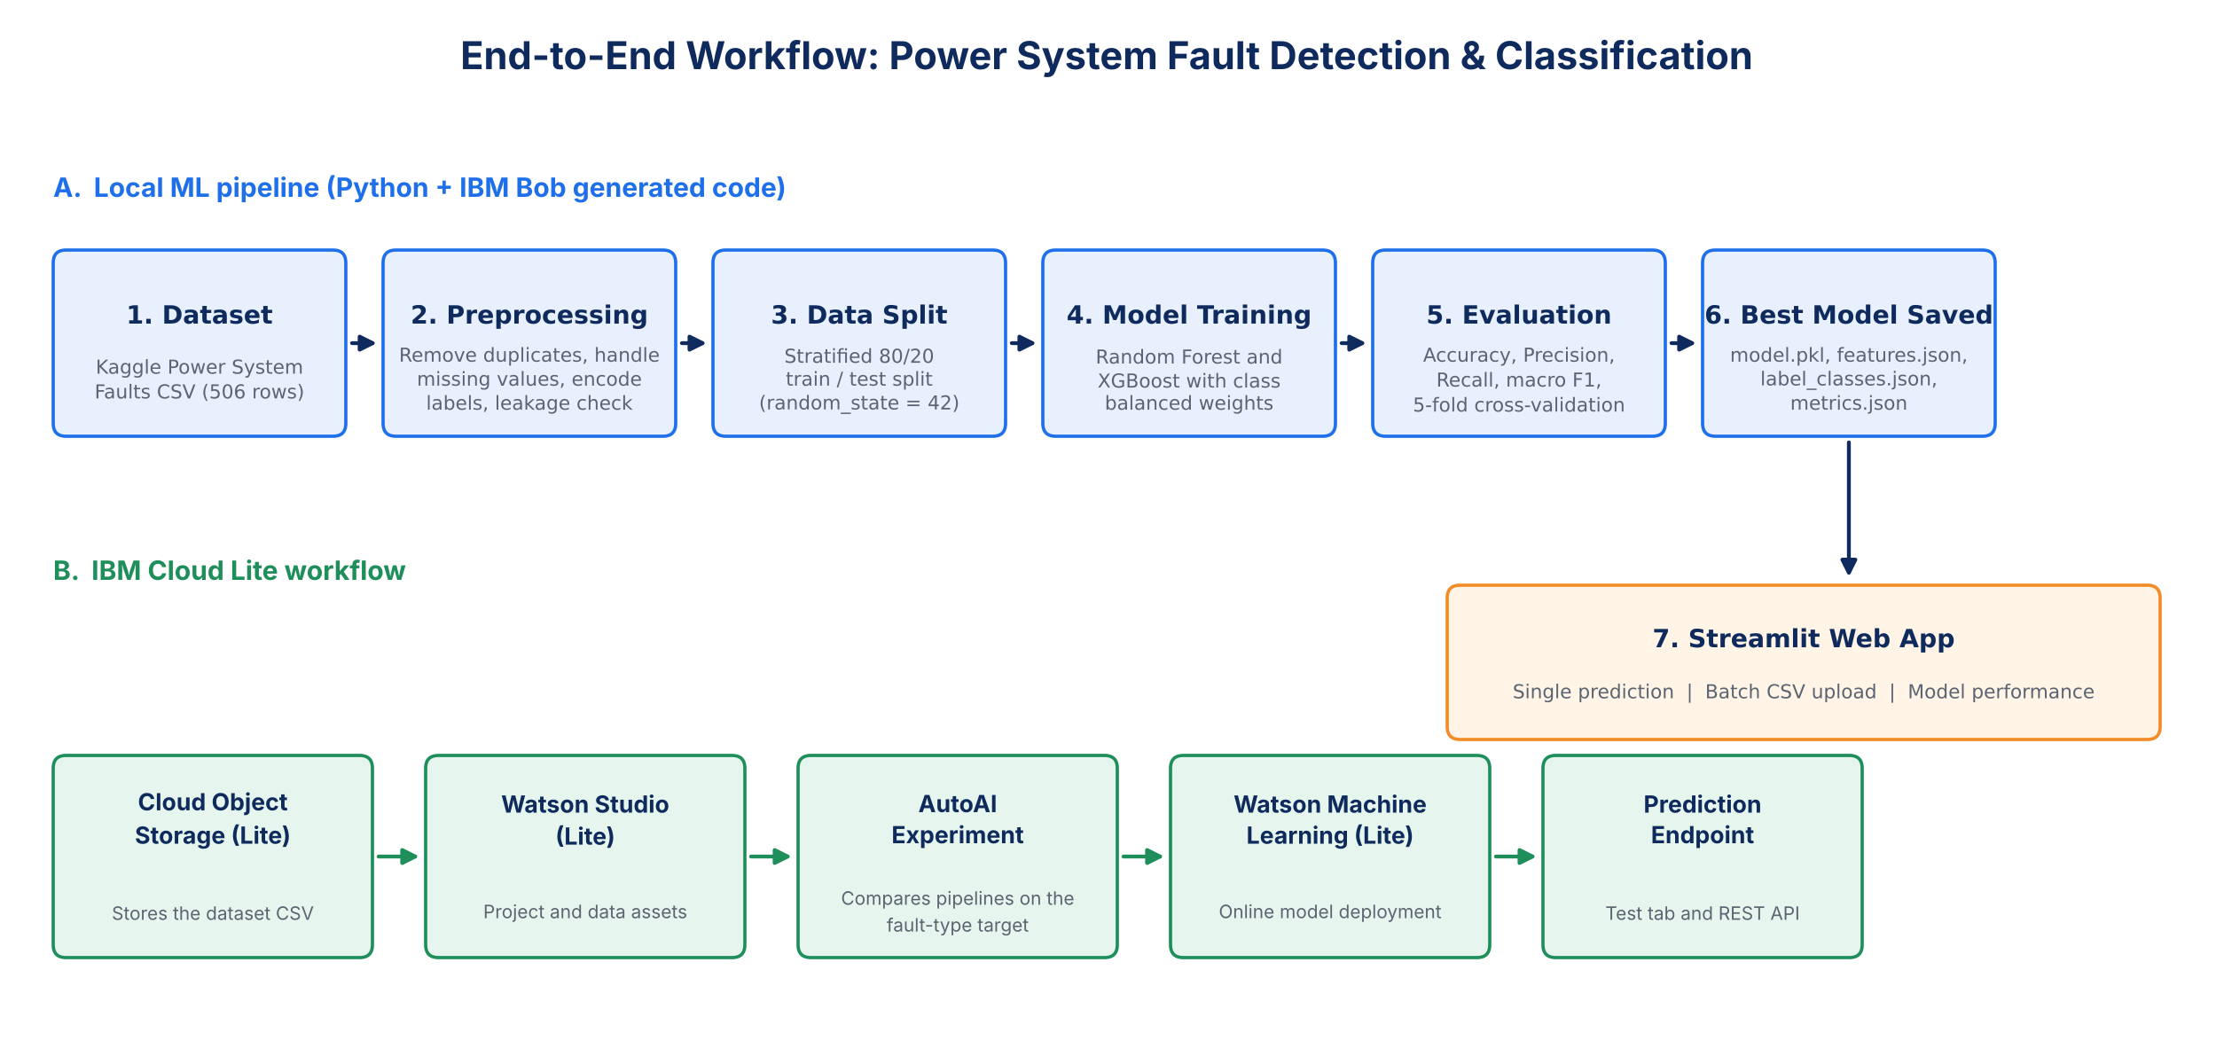
ML workflow -

Slide 8
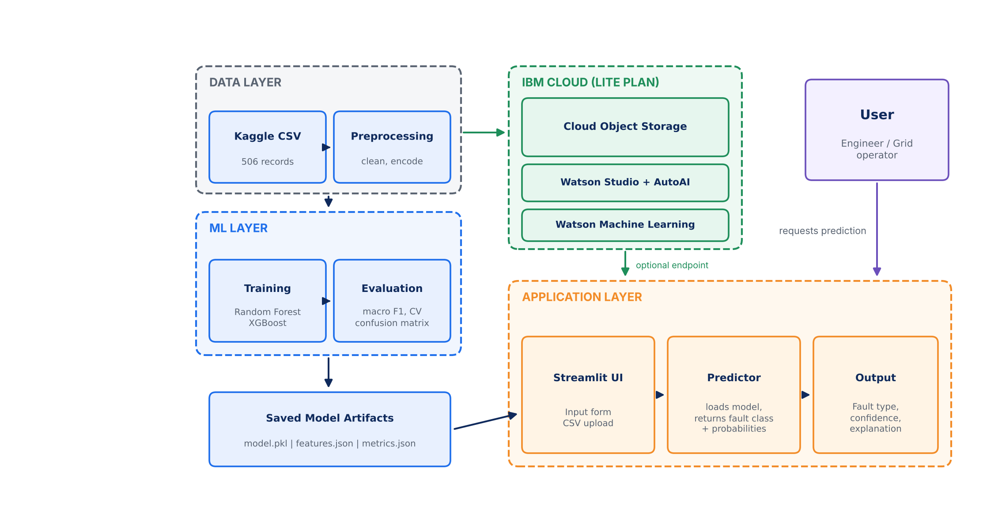
Architecture blueprint

Slide 9

Role of AI in the solution
Role of AI in Power System Fault Detection
Machine learning is the core of the solution. Random Forest and XGBoost models learn the link between sensor measurements (voltage, current, power load, temperature, weather, component health) and the type of fault, so faults are classified automatically instead of by manual inspection.
Models are trained with class-balanced weights and compared on macro F1 and cross-validation, so the system stays reliable even when some fault types are rare. Confidence scores show how sure the model is.
IBM Bob, an agentic AI coding assistant, helped build the project: it generated the pipeline and app, ran them and helped troubleshoot errors. IBM Cloud AutoAI adds automated model comparison and deployment.
Overall, AI makes fault diagnosis faster, consistent and data-driven, helping operators plan maintenance and reduce downtime.

Slide 10
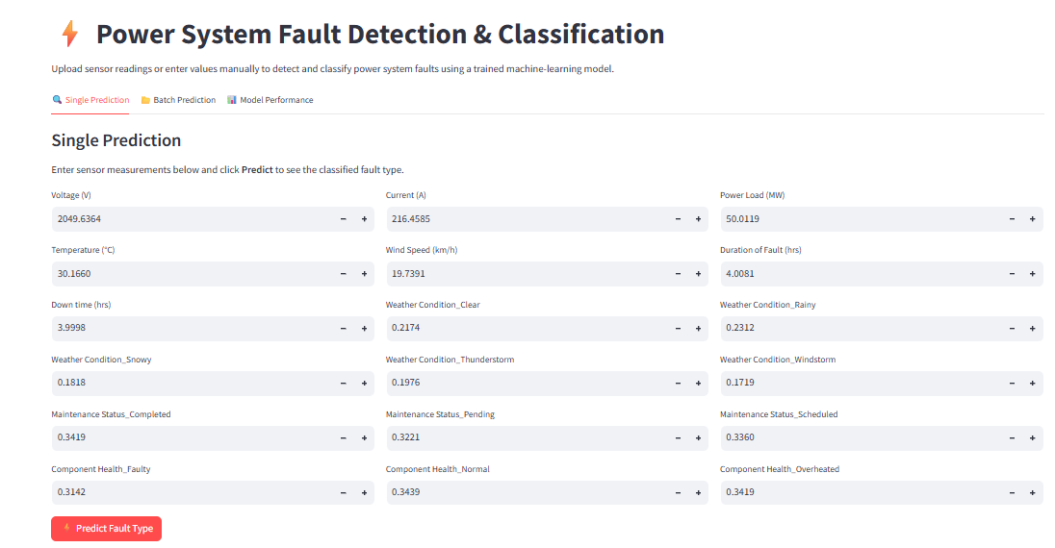
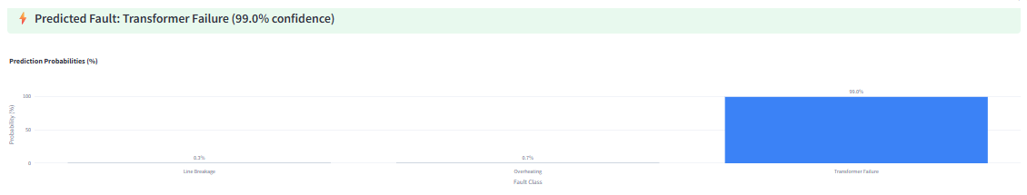
Token Usage
Input Form
Prediction Output
·
·
·

Slide 11
Novelty and Uniqueness
The proposed solution stands out by combining machine learning, a deployable web app and IBM Cloud into one end-to-end fault classification system.
Multi-Model Comparison – Random Forest and XGBoost are trained and compared; the best is chosen automatically by macro F1.
Imbalance & Leakage Aware – Class-balanced weights, stratified splits and a leakage check keep results trustworthy on a small dataset.
Explainable Output – Confidence scores, probability charts and feature importance show why a fault was predicted.
Plain-English Guidance – Each fault class comes with a short explanation to help non-experts act.
Single & Batch Prediction – Test one reading or upload a CSV and download predicted faults for many records.
Cloud-Ready on IBM – Cloud Object Storage, AutoAI in Watson Studio and deployment on Watson Machine Learning (Lite).
AI-Assisted Development – Built with IBM Bob, which shortened development and debugging time.
This makes the solution a fast, transparent and deployable fault diagnosis tool, not just an offline model.

Slide 12
Git Hub Link
Public GitHub repository (with README) – Power System Fault Detection using ML
Working GitHub URL – https://github.com/NiranjanaPeruma/power-system-fault-dectector
·
·
·

Slide 13
Future Scope
1. Real-Time Integration with SCADA / PMU Data –
Connect the model to live grid measurements so faults are detected and classified in real time, with instant alerts to operators.
2. Larger Datasets & Advanced Models –
Train on bigger, multi-utility datasets and try deep learning and explainable AI (SHAP) to improve accuracy and trust.
3. Predictive Maintenance Dashboard –
Add fault history, trend charts and maintenance scheduling so utilities can prevent failures before they happen.
·
·
·

Slide 14
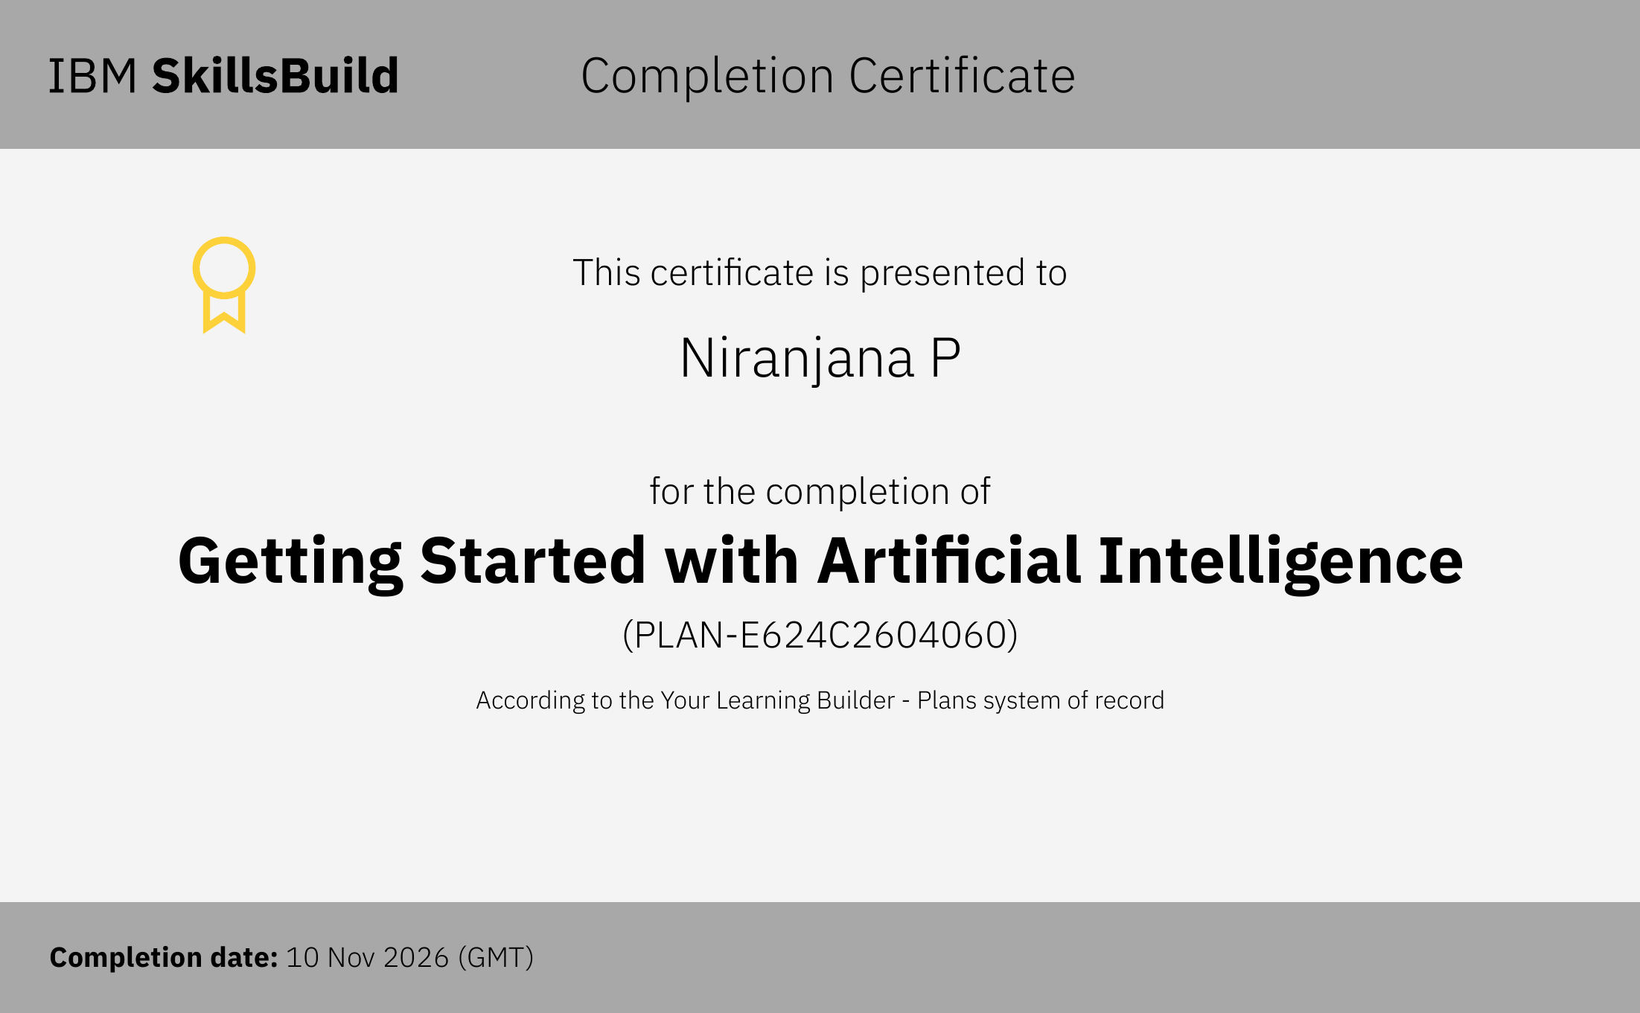
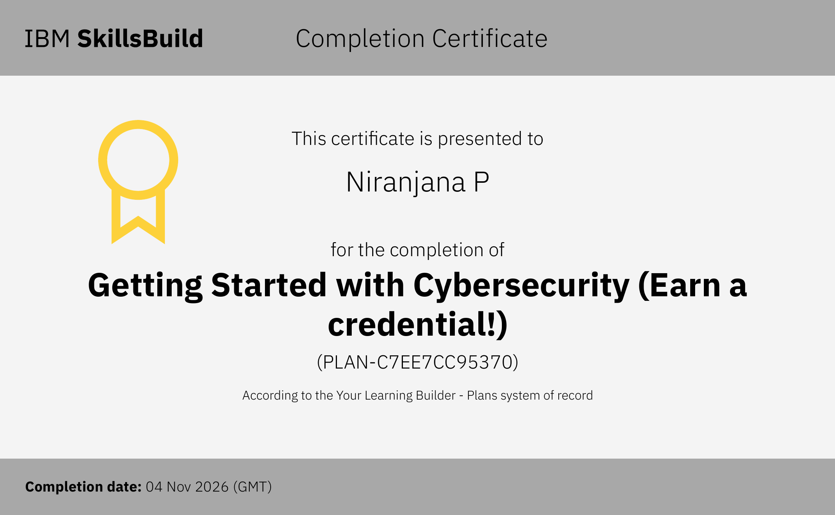

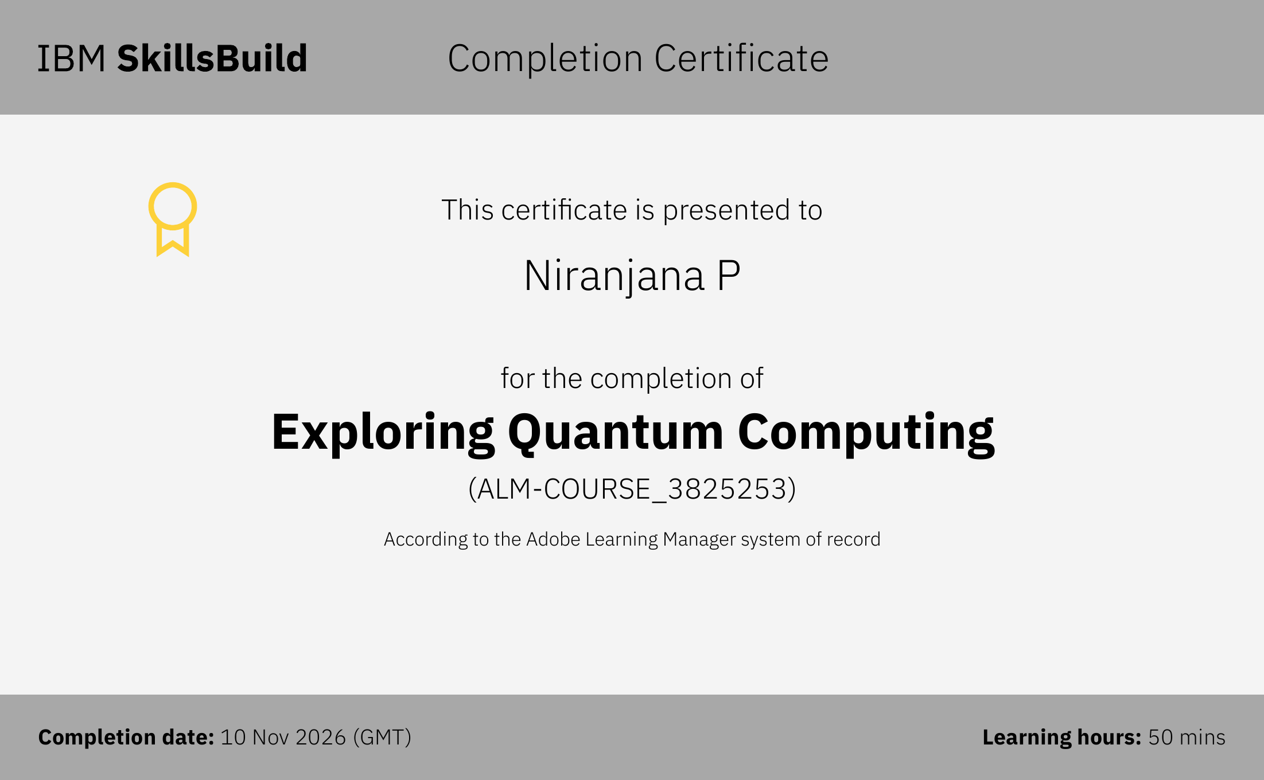
Certificates Earned:
IBM SkillsBuild Certificates

Slide 15
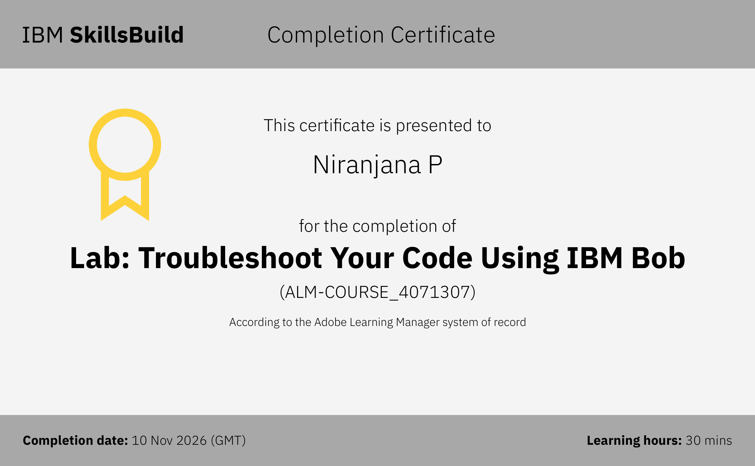
Certificates Earned:​
IBM Bob Certificate

Slide 16


